Slide 1
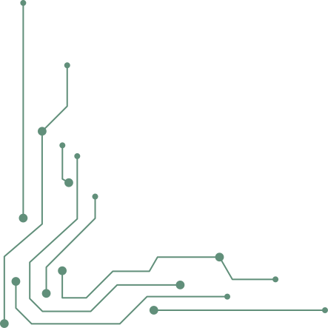


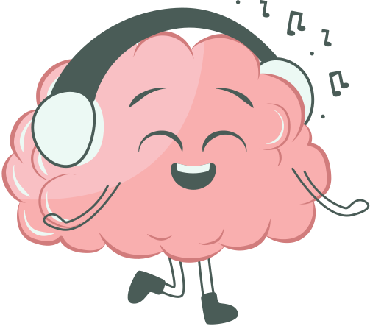
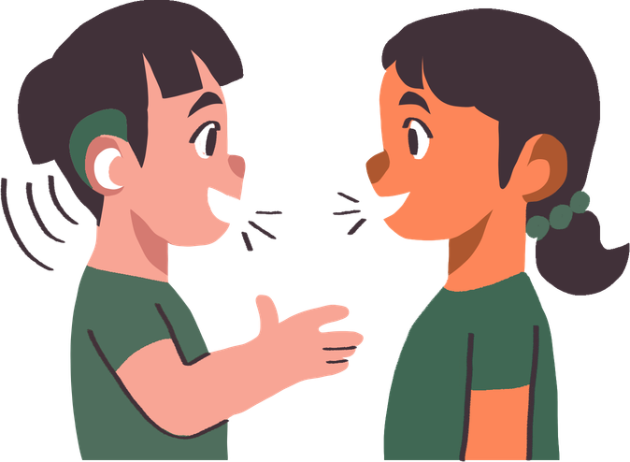
Introduction
Background
Methods
Results
Discussion
Conclusion
How Does the Brain Make Sense of Sound?

Slide 2
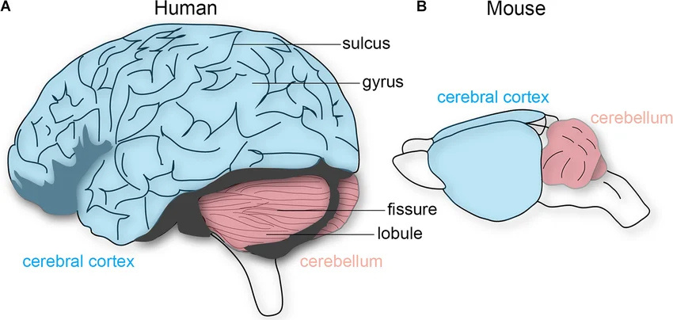



Introduction
Background
Methods
Results
Discussion
Conclusion
Shared Structure of the Mammalian Brain
All mammalian brains have a neocortex with six layers
With shared subcortical architectures¹
Thalamus relays sensory information to sensory cortices
Visual
Somatosensory
Auditory
Miterko, L. N., Lackey, E. P., Heck, D. H., & Sillitoe, R. V. (2018). Shaping Diversity Into the Brain's Form and Function. Frontiers in Neural Circuits, 12, 83. DOI: 10.3389/fncir.2018.00083 https://doi.org/10.3389/fncir.2018.00083

Slide 3
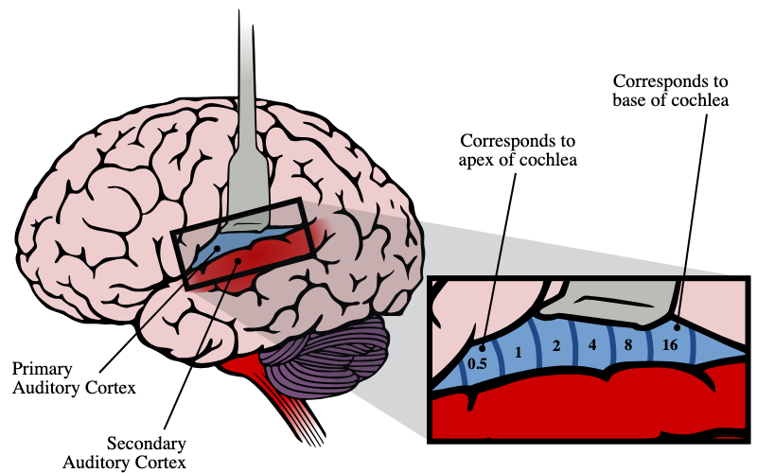
Introduction
Background
Methods
Results
Discussion
Conclusion
The Auditory Cortex (AC)
Located in the temporal lobe
Processes sound, from simple tones to complex speech
Humans: temporal lobe supports language, memory, and emotion
Mice:

Slide 4
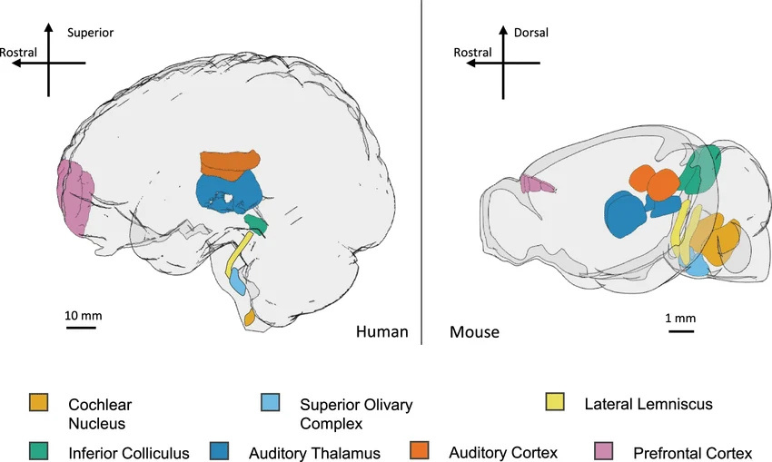
Introduction
Background
Methods
Results
Discussion
Conclusion
The Mouse
Genetic + circuit access
Tools to label neurons by type, silence them, watch them — at scale.
Comparable cortical layout
Same 6-layer plan, same major sensory areas, scaled smaller.
Behaviorally rich
Mice discriminate, generalize, and remember complex sounds.
Auditory processing in rodent models of autism: a systematic review - Scientific Figure on ResearchGate. Available from: https://www.researchgate.net/figure/Key-structures-in-the-auditory-processing-pathway-in-the-human-and-mouse-brain-Auditory_fig1_363127377 [accessed 8 May 2026]

Slide 5
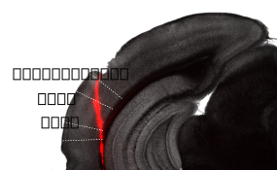
Introduction
Background
Methods
Results
Discussion
Conclusion
Cortical Subregions in Mouse AC

Slide 6
Introduction
Background
Methods
Results
Discussion
Conclusion
Previous Literature
Three competing frameworks
Parallel processing model (2000)
Distributed processing model (2001)
Hierarchical processing model (2014)
Single Neuron Studies

Slide 7
Introduction
Background
Methods
Results
Discussion
Conclusion
Gap in Knowledge
AudP is well characterized

Slide 8
Introduction
Background
Methods
Results
Discussion
Conclusion
Research Questions
How do the population responses of neurons differ across AC subregions?

Slide 9
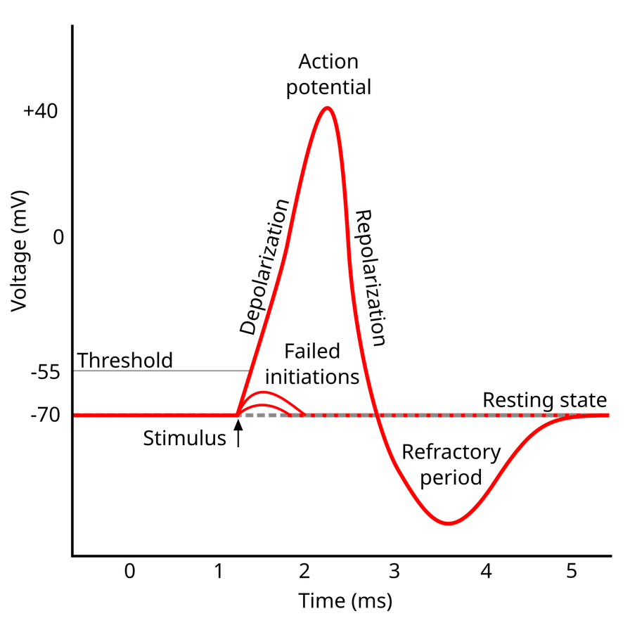
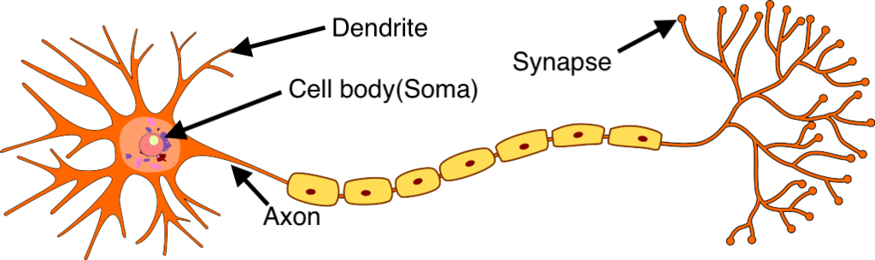
Introduction
Background
Methods
Results
Discussion
Conclusion
Neural Activity as a Response to Sound

Slide 10
Introduction
Background
Methods
Results
Discussion
Conclusion
Neuropixels 1.0
Record from hundreds of neurons activty from multiple subregions simultaneously
384
channels per probe
~1000
neurons per session
30 kHz
sampling rate
4 mice
in this study
10 mm shank

Slide 11

Introduction
Background
Methods
Results
Discussion
Conclusion
Experimental Design
Head-fixed mice listing to a range of sounds
record neuronal activity
Neuropixels 1.0 probes

Slide 12

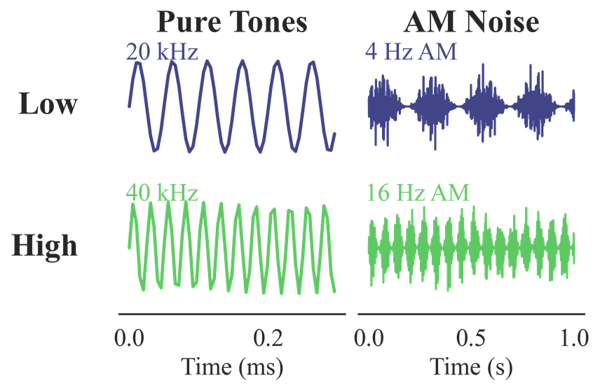
Introduction
Background
Methods
Results
Discussion
Conclusion
Experimental Design
Sounds
Pure tones (PT)
Amplitude modulated (AM)
Natural sounds
Speech
Frogs, birds, water — real soundscapes.
Spoken syllables.
Simple sine waves, varying frequency.
Tones with rhythmic envelope.
← simple complex →

Slide 13
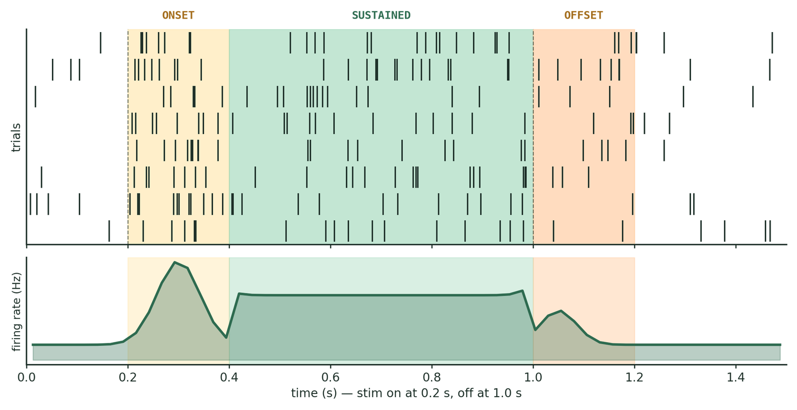
Introduction
Background
Methods
Results
Discussion
Conclusion
Spike Times ⟶ Firing Rates

Slide 14
Introduction
Background
Methods
Results
Discussion
Conclusion
Analyzing Population Responses
Encoding
Decoding

Slide 15
Introduction
Background
Methods
Results
Discussion
Conclusion
Previous Literature
Three competing frameworks
Parallel processing model (2000)
Distributed processing model (2001)
Hierarchical processing model (2014)

Slide 16
Introduction
Background
Methods
Results
Discussion
Conclusion
Firing rate
Firing rate

Slide 17
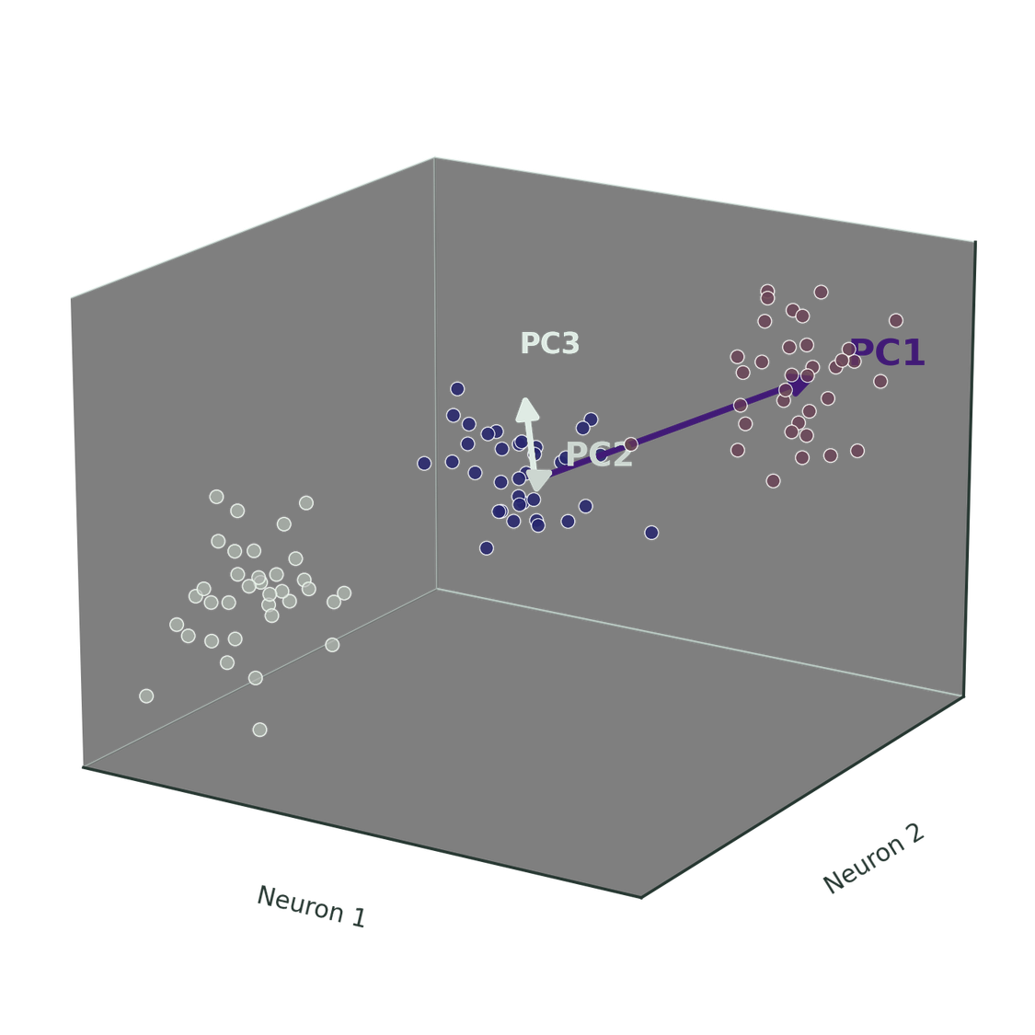
Introduction
Background
Methods
Results
Discussion
Conclusion

